Slide 1

School
Consolidation Advisory Committee
CAPACITY ANALYSIS
May 9, 2024
Updated September 2, 2024

Slide 2
Classroom Inventory

Slide 3
School Data Source
Enrollment Data
California Longitudinal Pupil Achievement Data System (CALPADS) report dated December 2023
Student Capacity Data
Total number of classrooms and portables—Facilities Master Plan
Standards used to calculate student capacity
  Grade TK-1 24 students per classroom
  Grade 2-3 26 students per classroom
Grade 4-5 30 students per classroom
  Grade 6-8 32 students per classroom
  Special Education (nonsevere) 12 students per classroom
  Special Education (severe) 10 students per classroom

Slide 4
School Capacity Calculations

Slide 5
School Capacity Calculations
ELEMENTARY | GRADE LEVEL | CLASSROOMS | LOADING | CAPACITY | ADDITIONAL
SCHOOLS |  |  |  |  | CAPACITY
 |  |  |  |  | (IF NEEDED)
BROOKTREE | TK - 1 | 6 | 24 | 144
 | 2-3 | 6 | 26 | 156
 | 4-5 | 1 | 30 | 30
 | SDC (nosevere) |  | 12
 | SDC (severe) | 4 | 10 | 40
 | Permanent Total | 17 |  | 370
 | Portables | 6 | 30 | 180
 | Total | 23 |  | 550
 | Portables (if needed) | 5 | 28 |  | 140
 | Total (if needed) | 28 |  |  | 690
CHERRYWOOD | TK - 1 | 6 | 24 | 144
 | 2-3 | 8 | 26 | 208
 | 4-5 | 3 | 30 | 90
 | SDC (nosevere) | 1 | 12 | 12
 | SDC (severe) |  | 10
 | Permanent Total | 18 |  | 454
 | Portables | 8 | 30 | 240
 | Total | 26 |  | 694
 | Portables (if needed) | 3 | 28 |  | 84
 | Total (if needed) | 29 |  |  | 778

Slide 6
School Capacity Calculations
ELEMENTARY | GRADE LEVEL | CLASSROOMS | LOADING | CAPACITY | ADDITIONAL
SCHOOLS |  |  |  |  | CAPACITY
 |  |  |  |  | (IF NEEDED)
LANEVIEW | TK - 1 | 7 | 24 | 168
 | 2-3 | 7 | 26 | 182
 | 4-5 | 2 | 30 | 60
 | SDC (nosevere) |  | 12
 | SDC (severe) | 3 | 10 | 30
 | Permanent Total | 19 |  | 440
 | Portables | 5 | 30 | 150
 | Total | 24 |  | 590
 | Portables (if needed) | 4 | 28 |  | 112
 | Total (if needed) | 28 |  |  | 702
MAJESTIC WAY | TK - 1 | 7 | 24 | 168
 | 2-3 | 6 | 26 | 156
 | 4-5 | 2 | 30 | 60
 | SDC (nosevere) | 2 | 12 | 24
 | SDC (severe) |  | 10
 | Permanent Total | 17 |  | 408
 | Portables | 6 | 30 | 180
 | Total | 23 |  | 588
 | Portables (if needed) | 5 | 28 |  | 140
 | Total (if needed) | 28 |  |  | 728

Slide 7
School Capacity Calculations
ELEMENTARY | GRADE LEVEL | CLASSROOMS | LOADING | CAPACITY | ADDITIONAL
SCHOOLS |  |  |  |  | CAPACITY
 |  |  |  |  | (IF NEEDED)
NOBLE | TK - 1 | 7 | 24 | 168
 | 2-3 | 6 | 26 | 156
 | 4-5 | 7 | 30 | 210
 | SDC (nosevere) | 2 | 12 | 24
 | SDC (severe) |  | 10
 | Permanent Total | 22 |  | 558
 | Portables |  | 30
 | Total | 22 |  | 558
 | Portables (if needed) | 4 | 28 |  | 112
 | Total (if needed) | 26 |  |  | 670
NORTHWOOD | TK - 1 | 8 | 24 | 192
 | 2-3 | 8 | 26 | 208
 | 4-5 | 5 | 30 | 150
 | SDC (nosevere) |  | 12
 | SDC (severe) |  | 10
 | Permanent Total | 21 |  | 550
 | Portables | 4 | 30 | 120
 | Total | 25 |  | 670
 | Portables (if needed) | 3 | 28 |  | 84
 | Total (if needed) | 28 |  |  | 754

Slide 8
School Capacity Calculations
ELEMENTARY | GRADE LEVEL | CLASSROOMS | LOADING | CAPACITY | ADDITIONAL
SCHOOLS |  |  |  |  | CAPACITY
 |  |  |  |  | (IF NEEDED)
RUSKIN | TK - 1 | 9 | 24 | 216
 | 2-3 | 8 | 26 | 208
 | 4-5 | 6 | 30 | 180
 | SDC (nosevere) | 1 | 12 | 12
 | SDC (severe) |  | 10
 | Permanent Total | 24 |  | 616
 | Portables | 3 | 30 | 90
 | Total | 27 |  | 706
 | Portables (if needed) | 1 | 28 |  | 28
 | Total (if needed) | 28 |  |  | 734
SUMMERDALE | TK - 1 | 8 | 24 | 192
 | 2-3 | 7 | 26 | 182
 | 4-5 | 2 | 30 | 60
 | SDC (nosevere) |  | 12
 | SDC (severe) |  | 10
 | Permanent Total | 17 |  | 434
 | Portables | 6 | 30 | 180
 | Total | 23 |  | 614
 | Portables (if needed) | 3 | 28 |  | 84
 | Total (if needed) | 26 |  |  | 698

Slide 9
School Capacity Calculations
MIDDLE SCHOOLS | GRADE | CLASSROOM | LOADING | CAPACITY | ADDITIONAL
 |  |  |  |  | CAPACITY
 |  |  |  |  | (IF NEEDED)
MORRILL | 6-8 | 28 | 32 | 896
 | SDC (nosevere) | 4 | 12 | 48
 | SDC (severe) |  | 10
 | Permanent Total | 32 |  | 944
 | Portables | 2 | 32 | 64
 | Total | 34 |  | 1,008
 | Portables (if needed) | 5 | 32 |  | 160
 | Total (if needed) | 39 |  |  | 1,168
PIEDMONT | 6-8 | 25 | 32 | 800
 | SDC (nosevere) | 3 | 12 | 36
 | SDC (severe) |  | 10
 | Permanent Total | 28 |  | 836
 | Portables | 5 | 32 | 160
 | Total | 33 |  | 996
 | Portables (if needed) | 3 | 32 |  | 96
 | Total (if needed) | 36 |  |  | 1,092

Slide 10
School Capacity Calculations

Slide 11
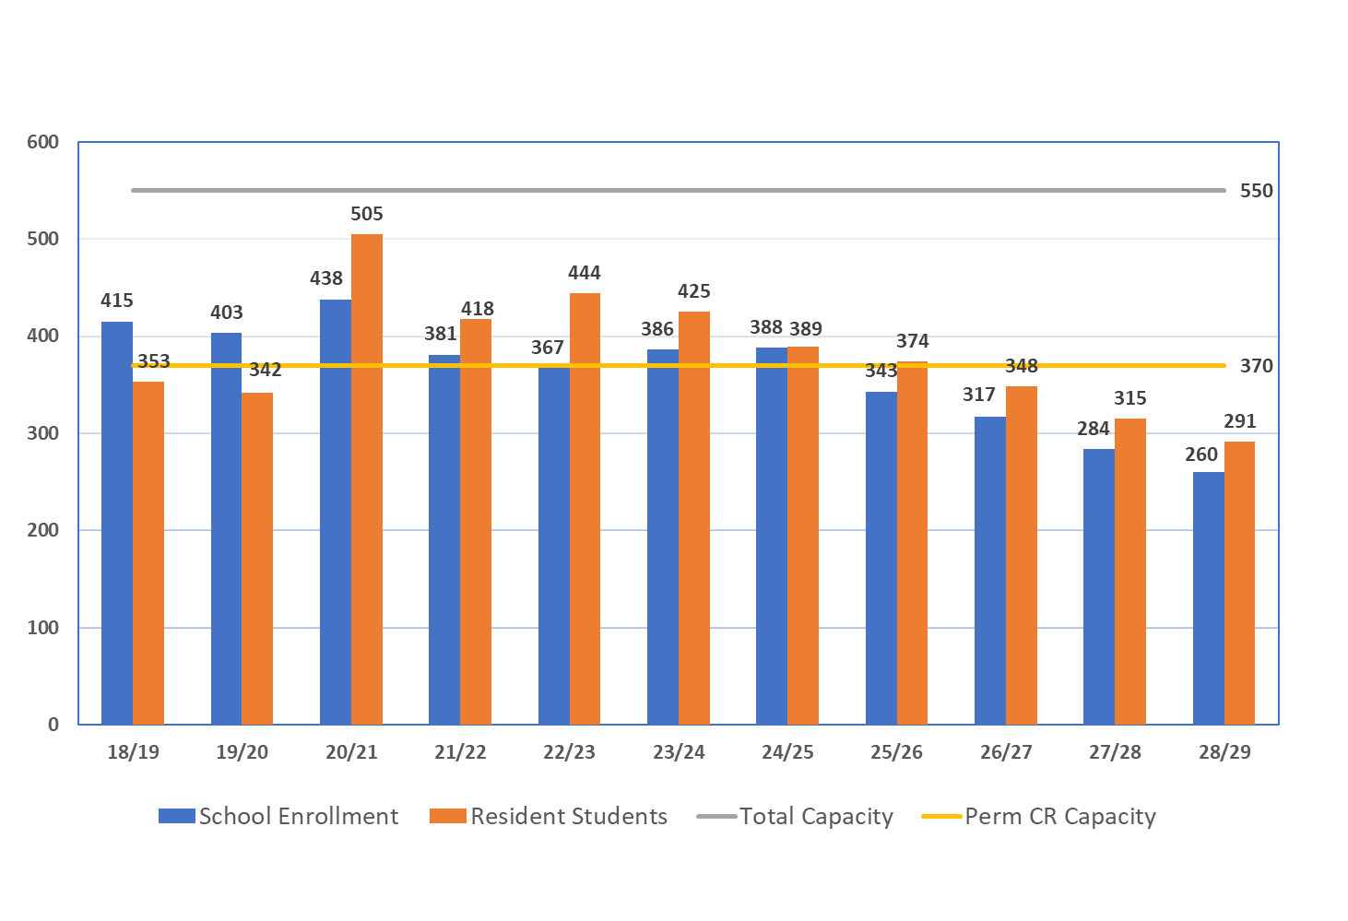
Capacity and Projected Enrollment
Brooktree Elementary

Slide 12
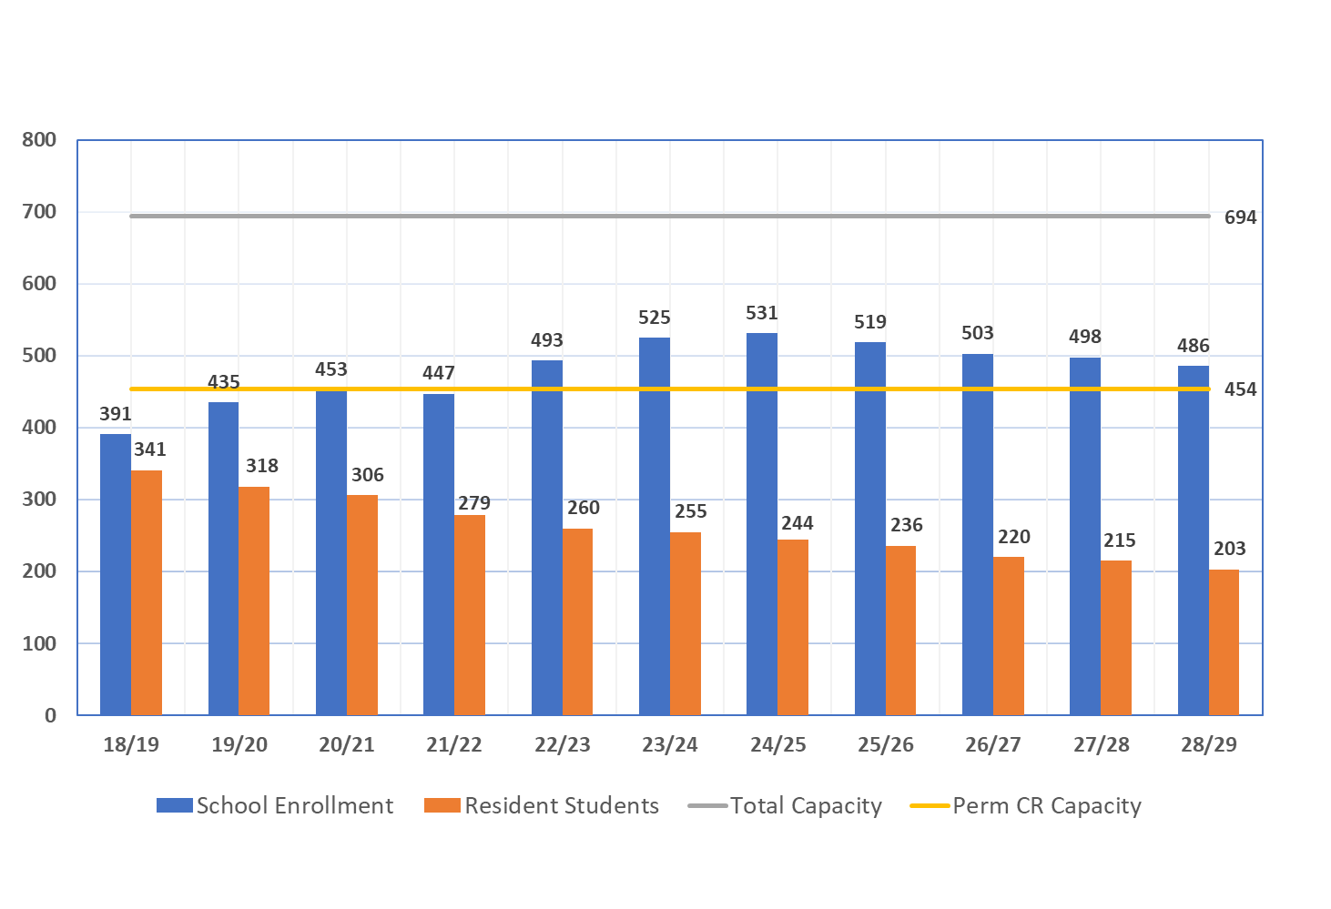
Capacity and Projected Enrollment
Cherrywood Elementary

Slide 13
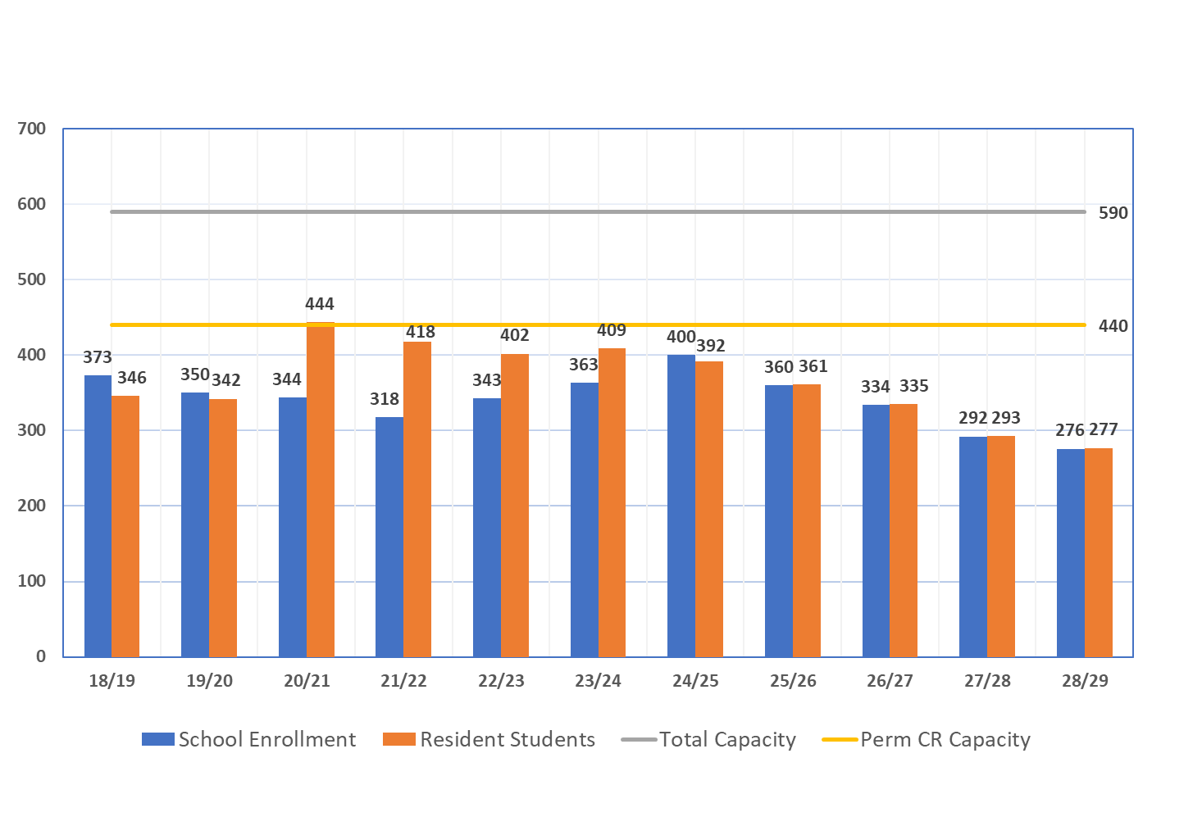
Capacity and Projected Enrollment
Laneview Elementary

Slide 14
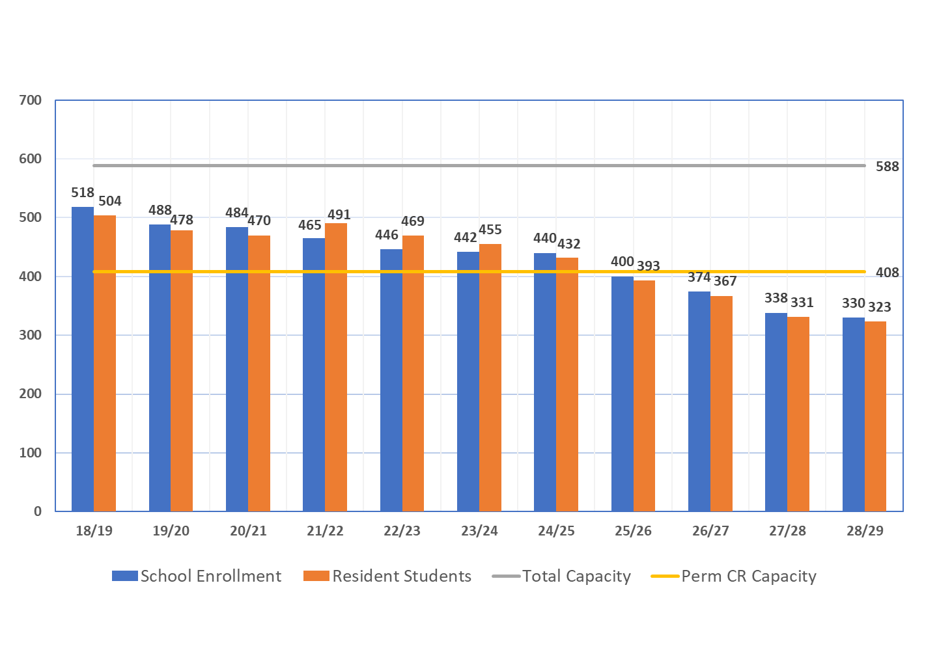
Capacity and Projected Enrollment
Majestic Way Elementary

Slide 15
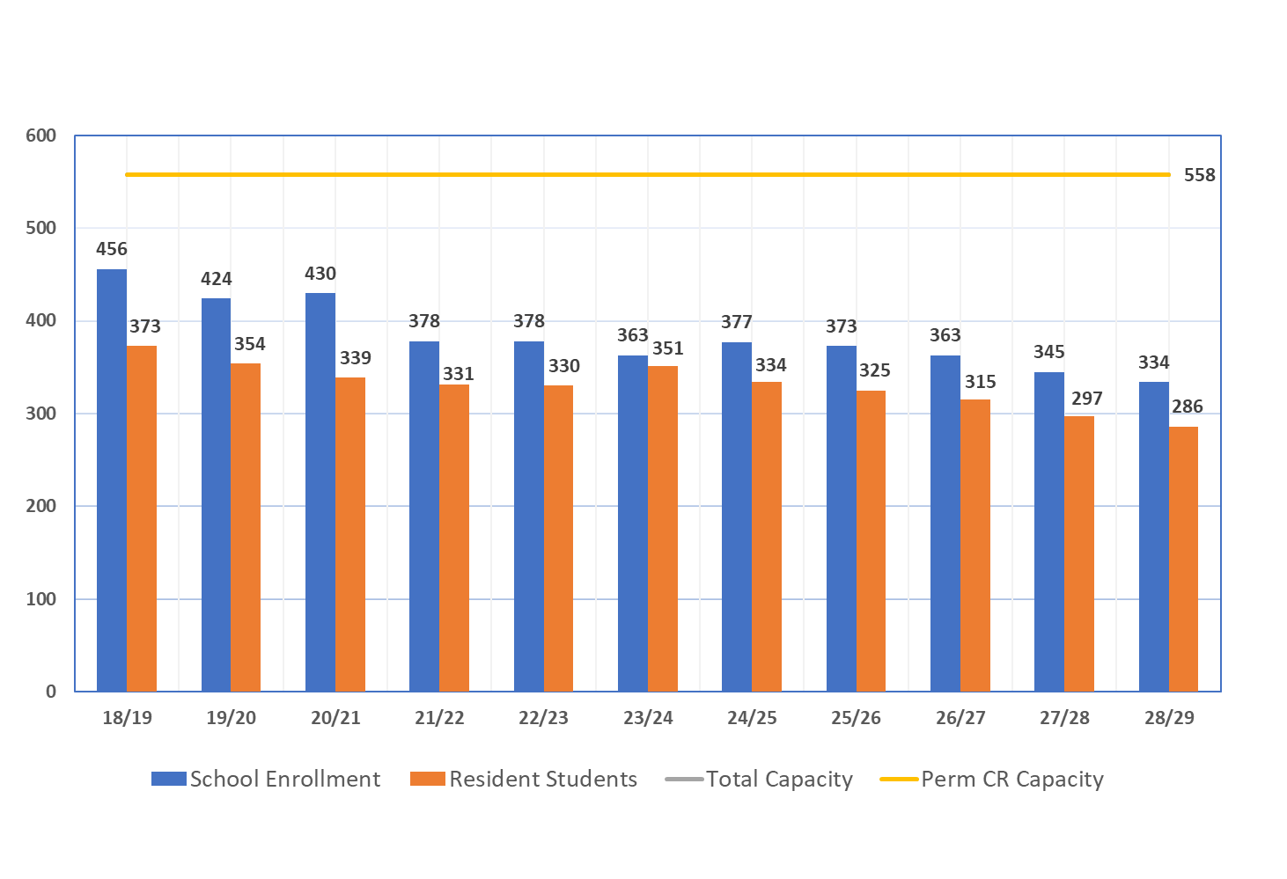
Capacity and Projected Enrollment
Noble Elementary

Slide 16
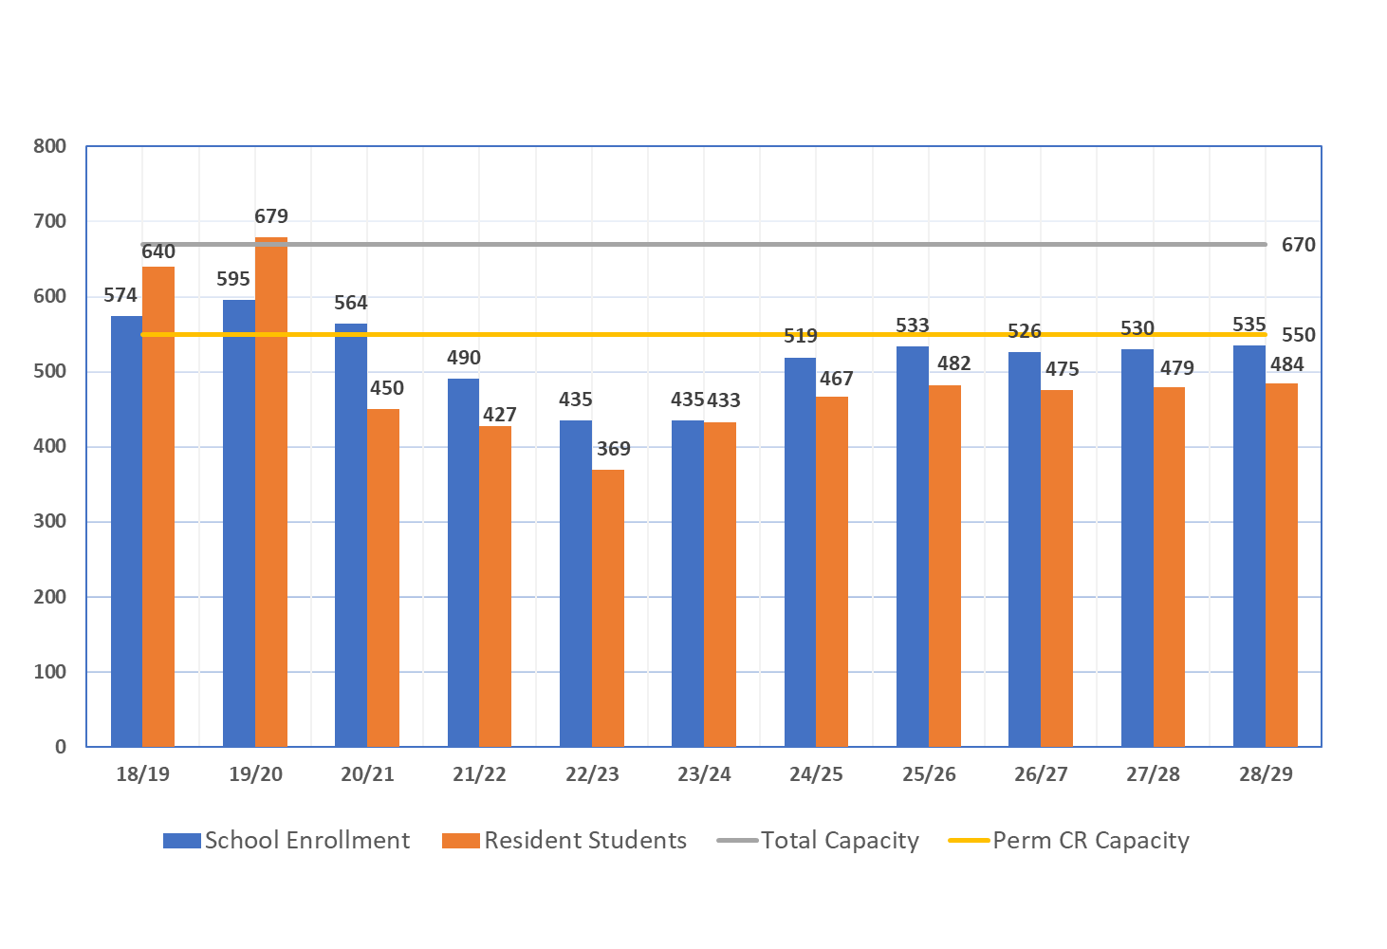
Capacity and Projected Enrollment
Northwood Elementary

Slide 17
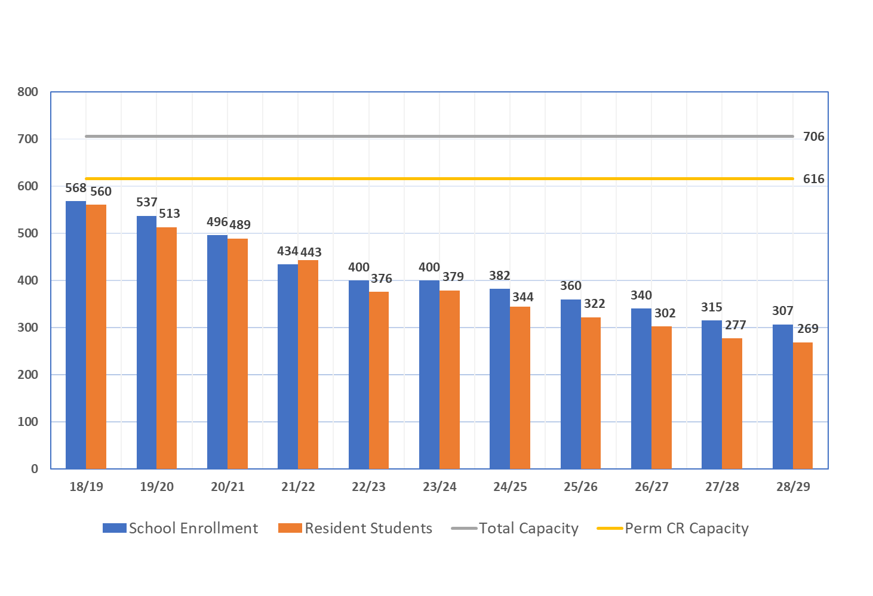
Capacity and Projected Enrollment
Ruskin Elementary

Slide 18
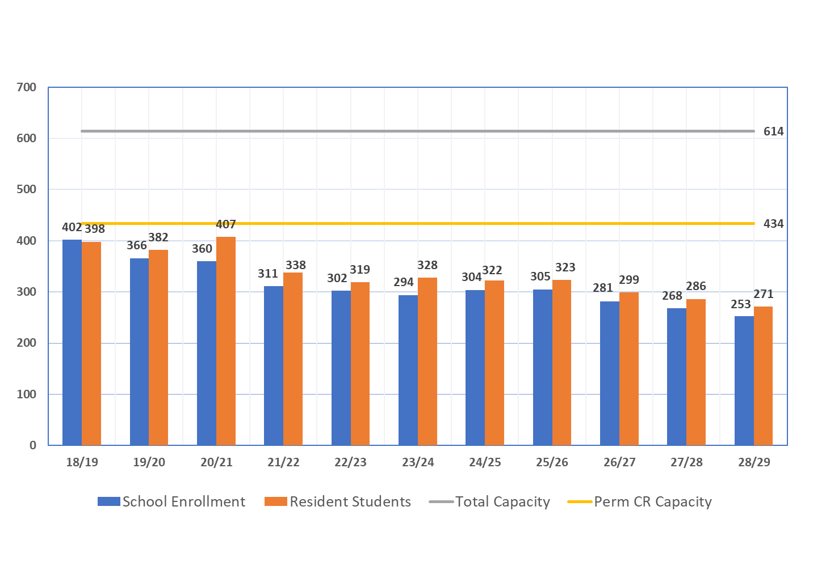
Capacity and Projected Enrollment
Summerdale Elementary

Slide 19
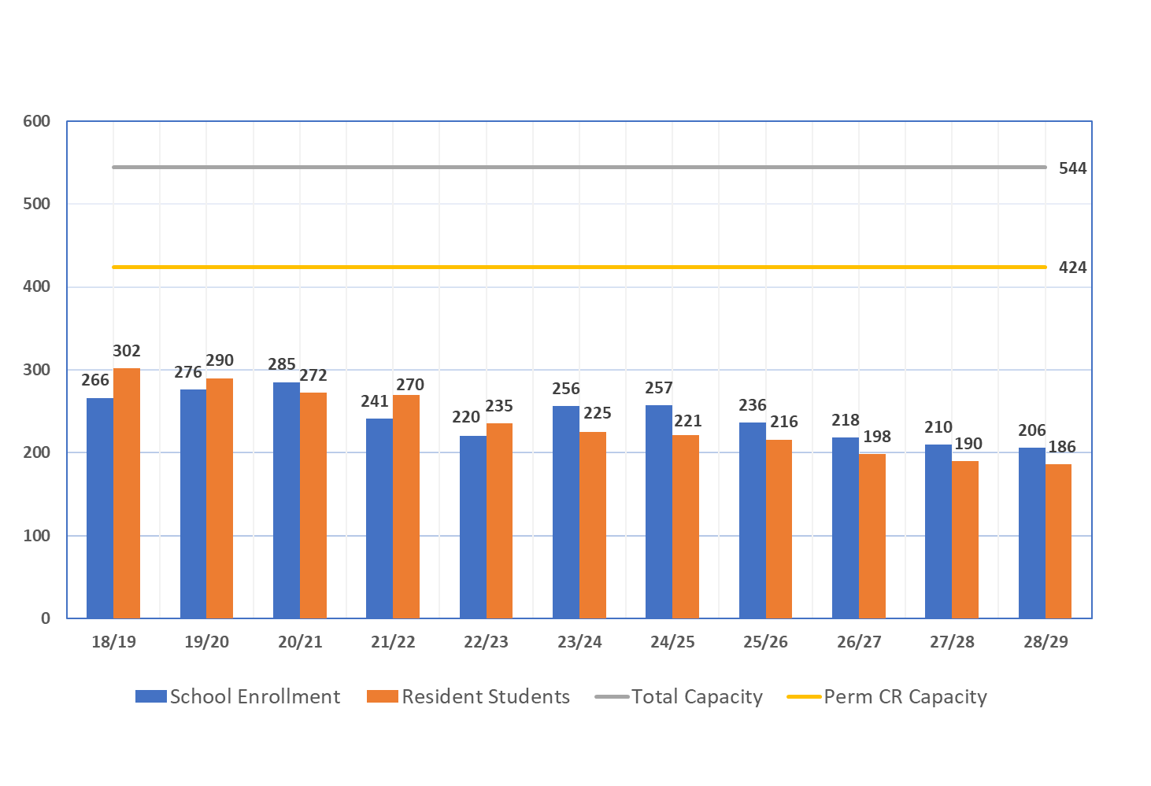
Capacity and Projected Enrollment
Toyon Elementary

Slide 20
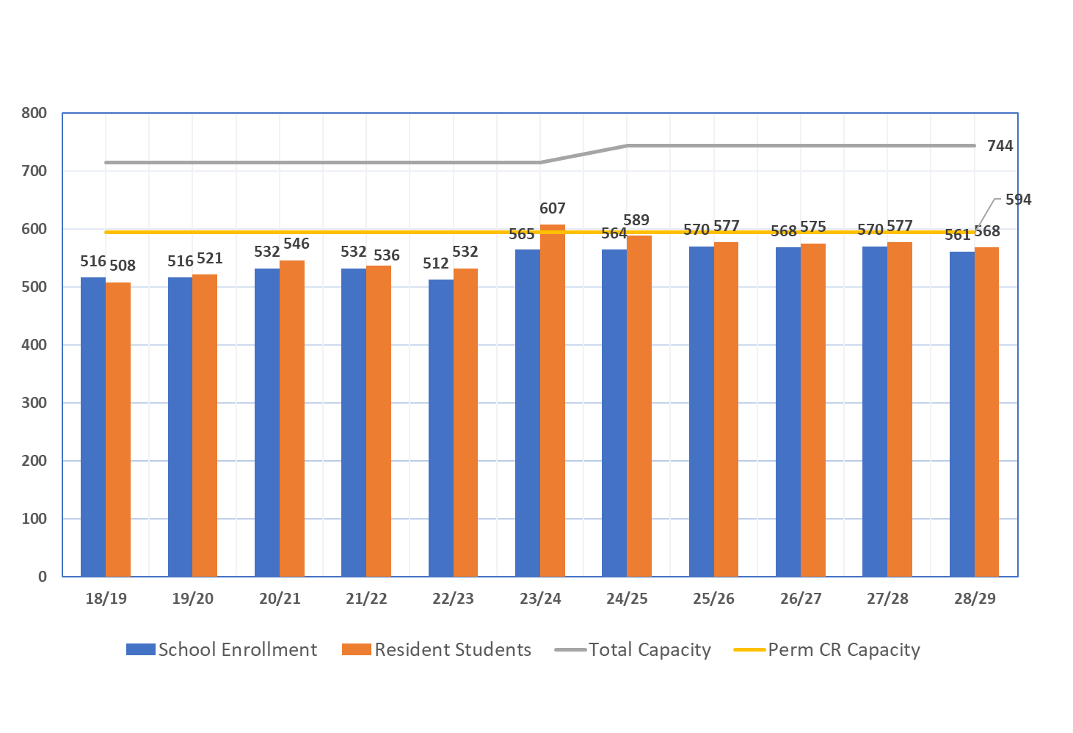
Capacity and Projected Enrollment
Vinci Park Elementary

Slide 21
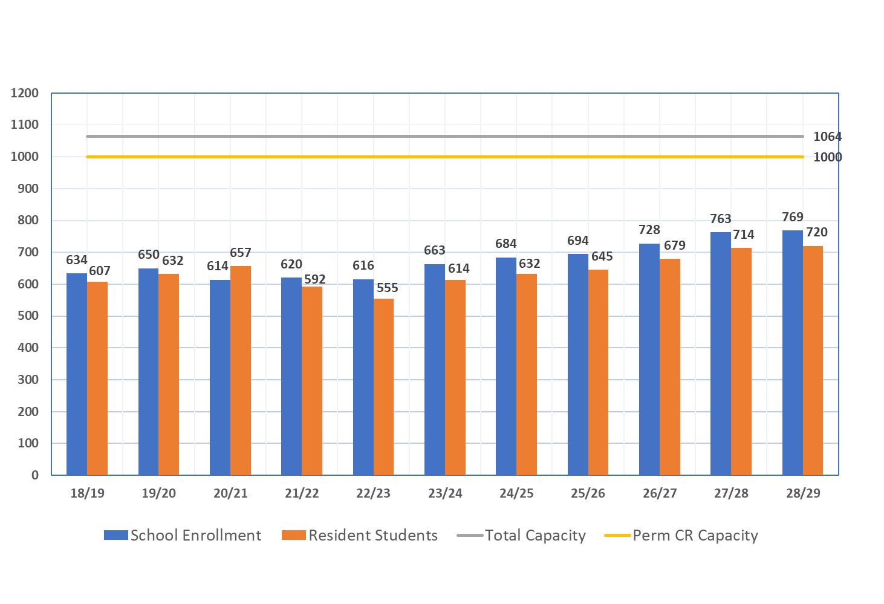
Capacity and Projected Enrollment
Morrill Middle

Slide 22
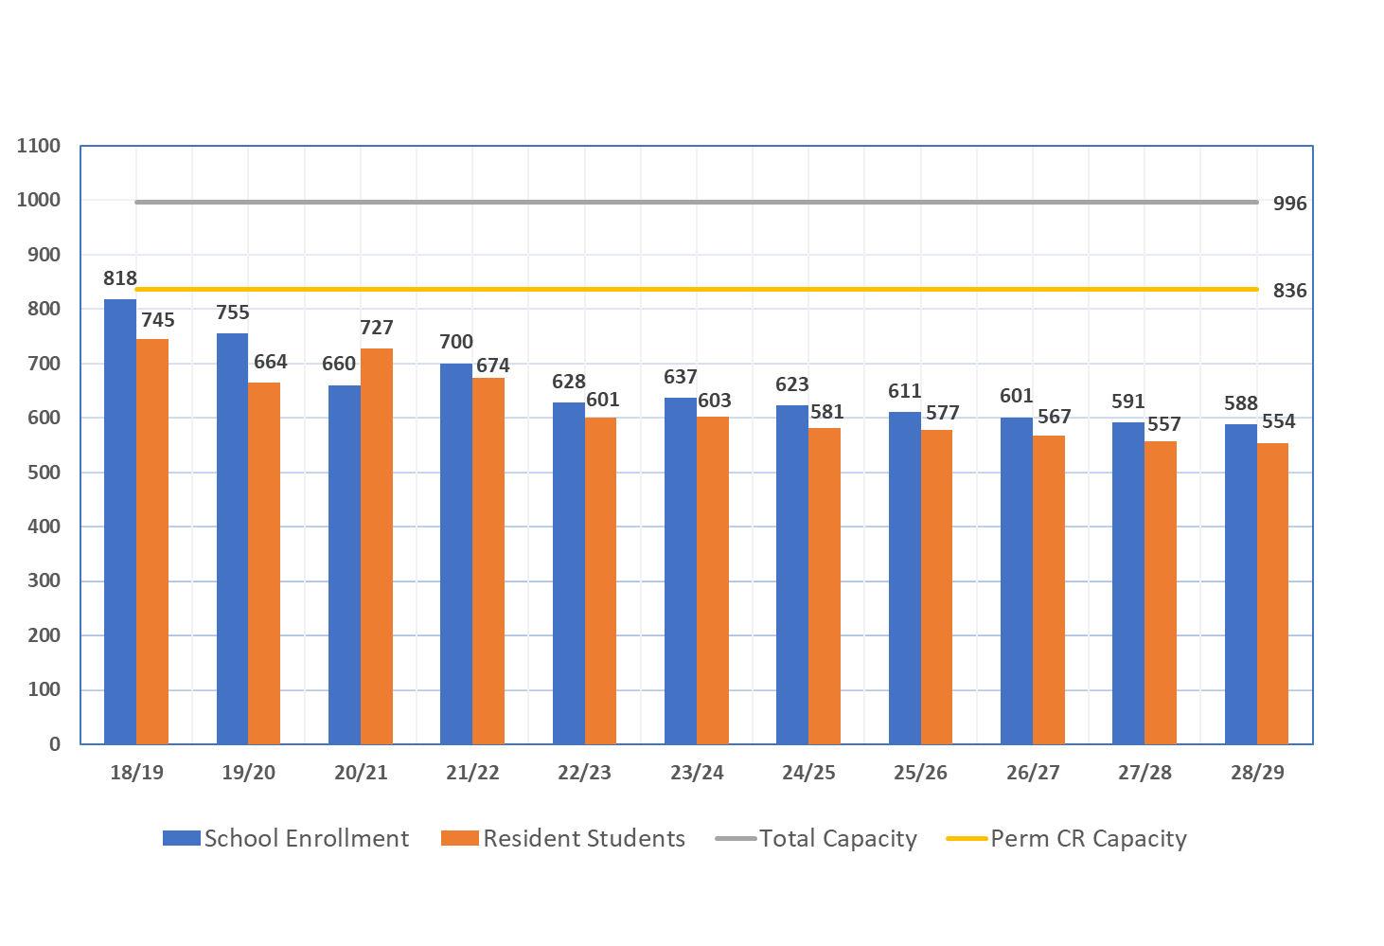
Capacity and Projected Enrollment
Piedmont Middle

Slide 23
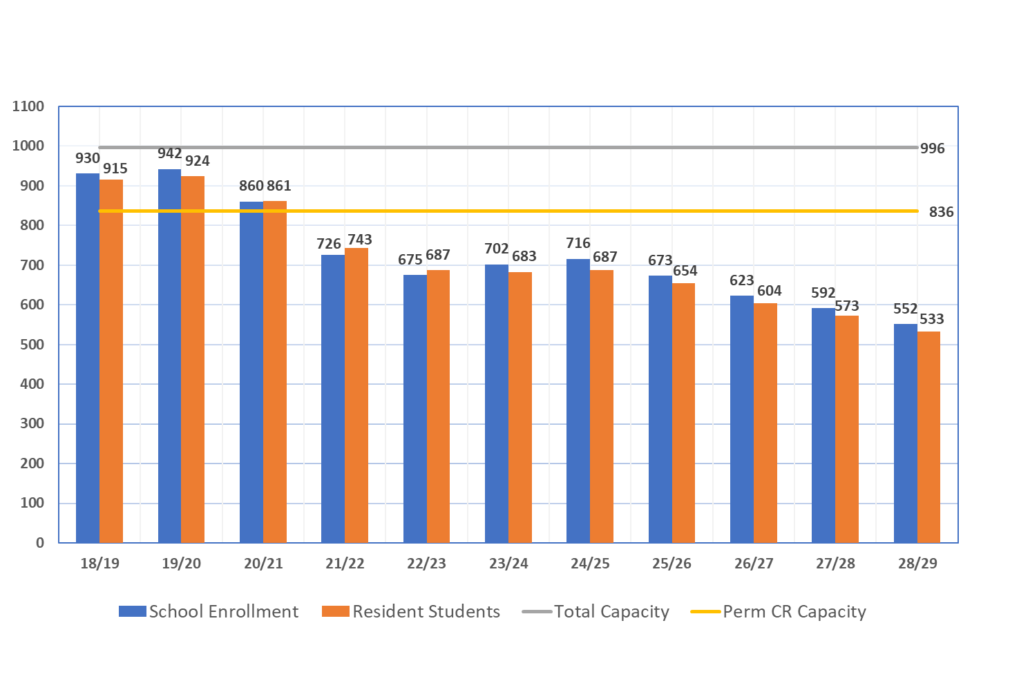
Capacity and Projected Enrollment
Sierramont Middle

Slide 24
Utilization Rates 2023-24

Slide 25
Utilization Rates 2025-26

Slide 26
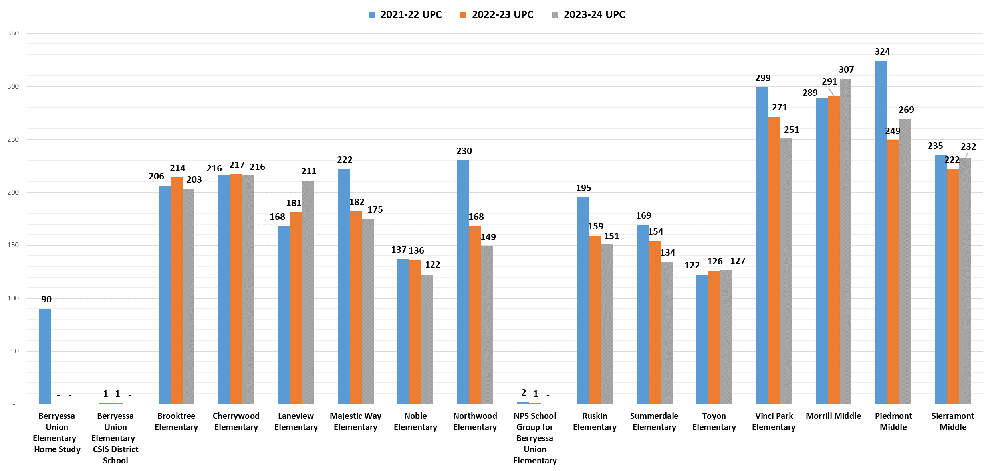
Unduplicated Pupil Count

Slide 27
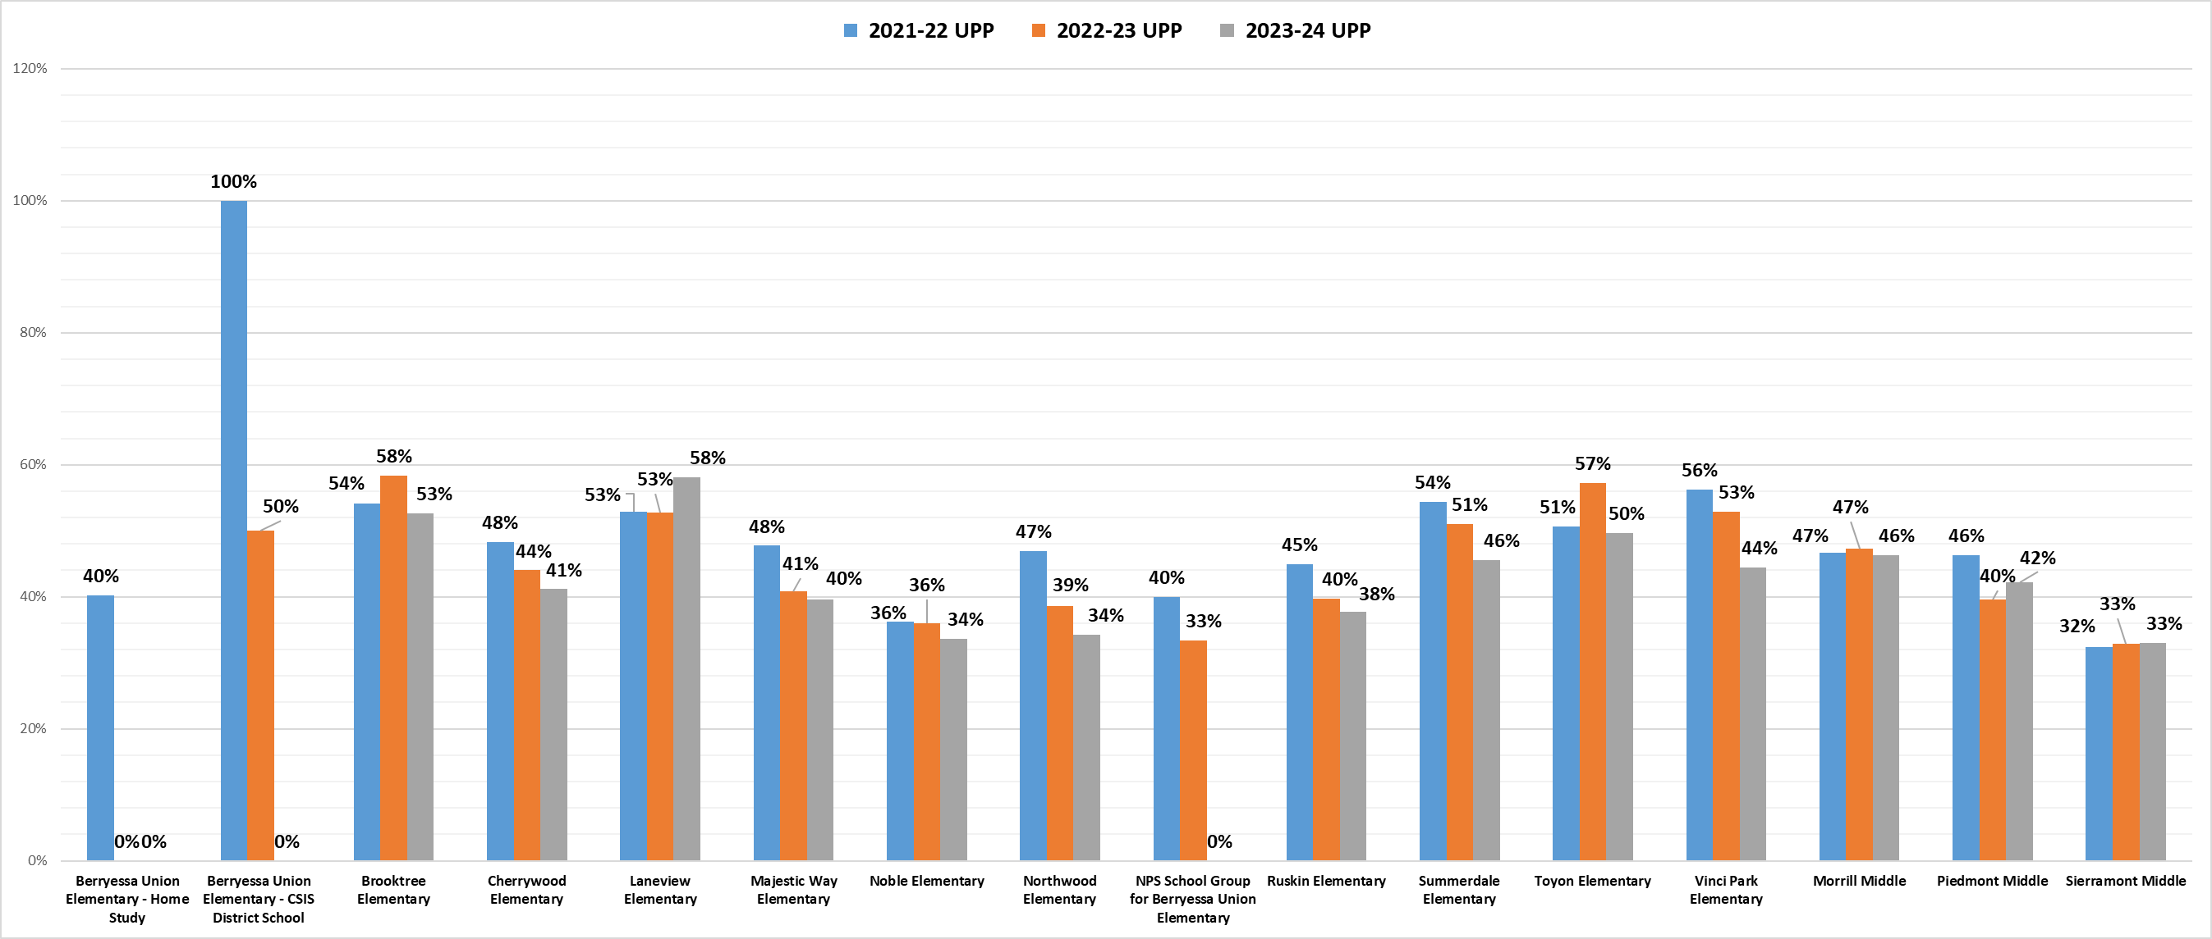
Unduplicated Pupil Count Calculated

Slide 28
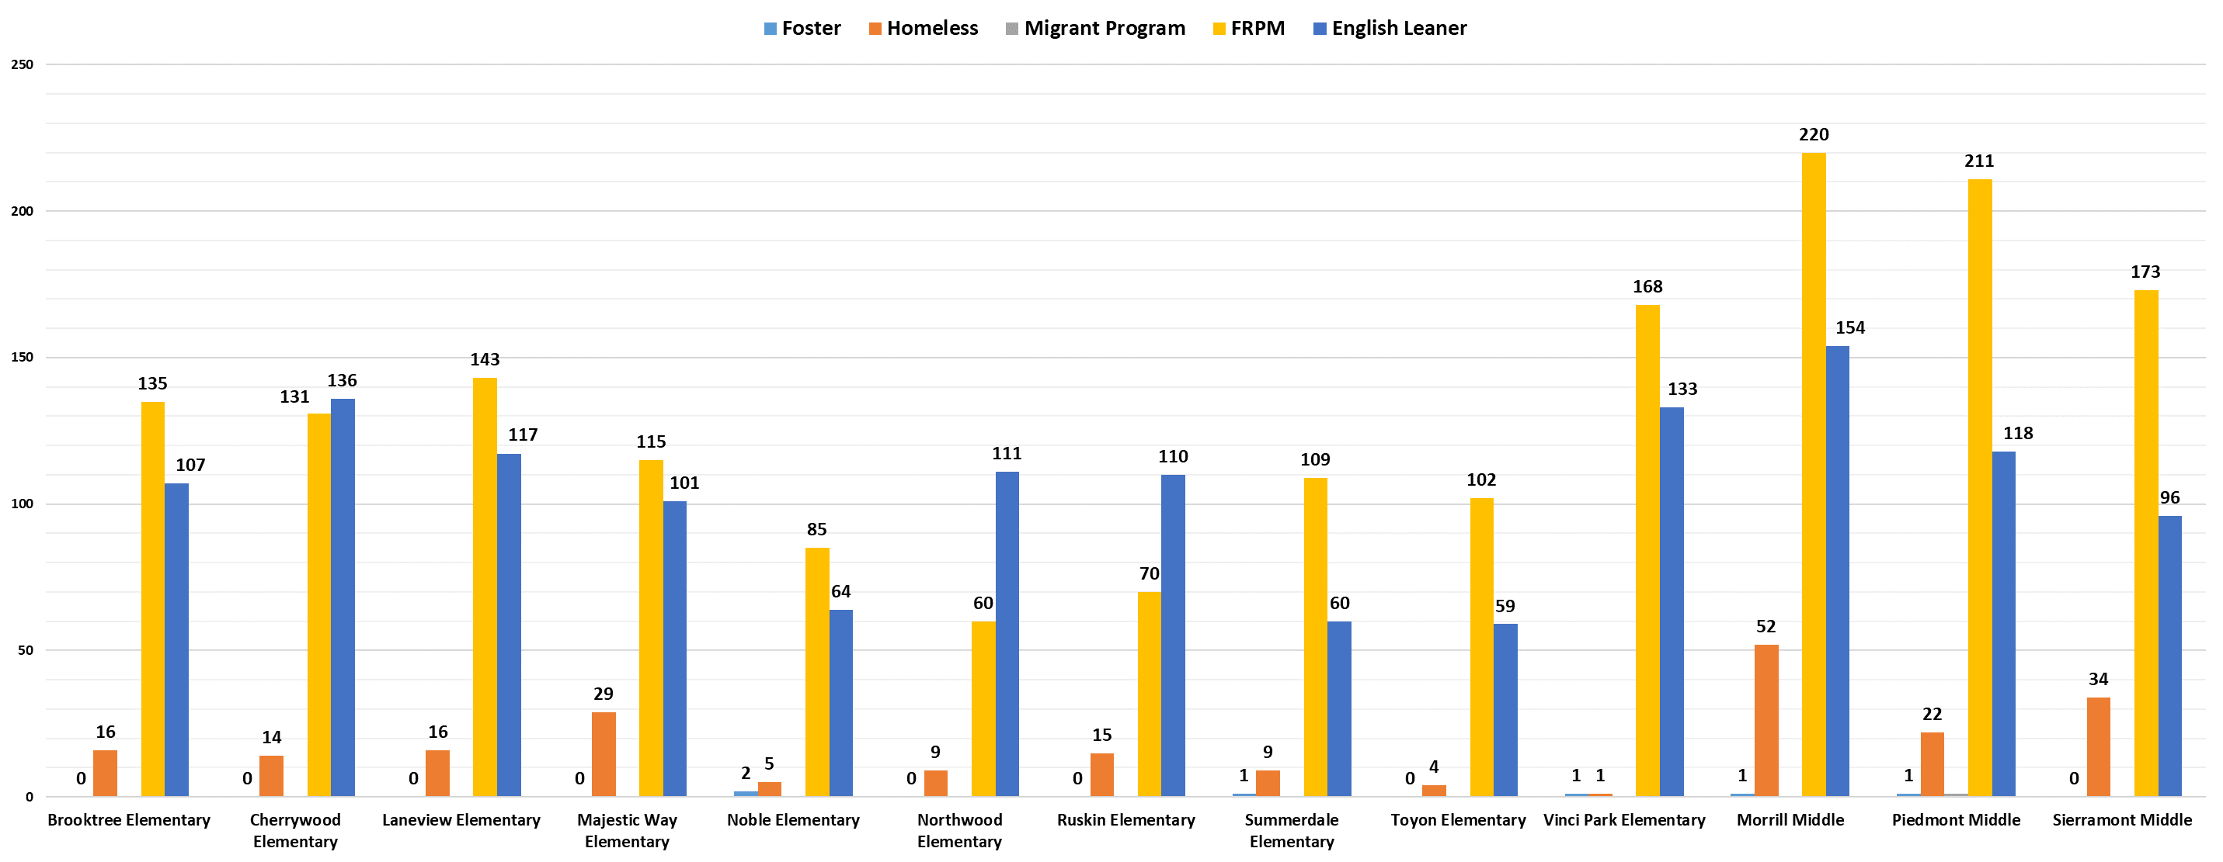
2023-24 Unduplicated Pupil Count by Type

Slide 29
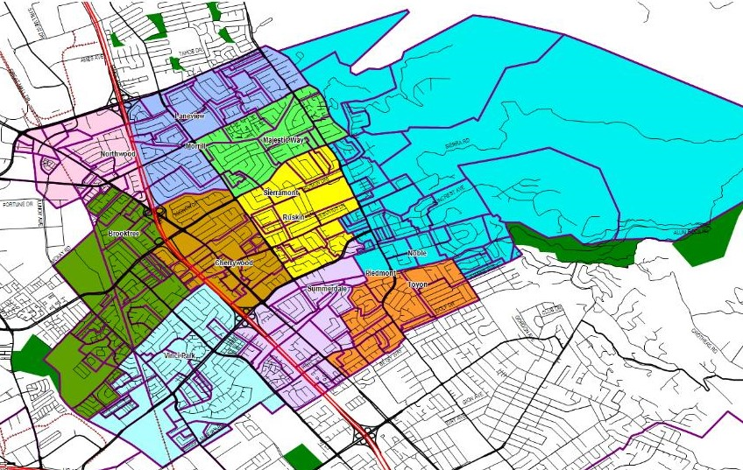
Elementary School Boundaries

Slide 30
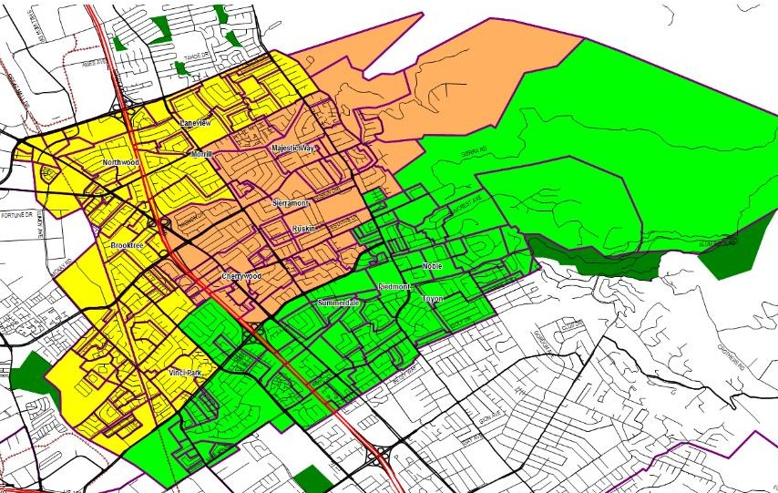
Middle School Boundaries

Slide 31
Questions?
Thank you

